Slide 1

Topic: Measurement
EQ: How do we work out the surface area of cylindrical prisms?

Slide 2
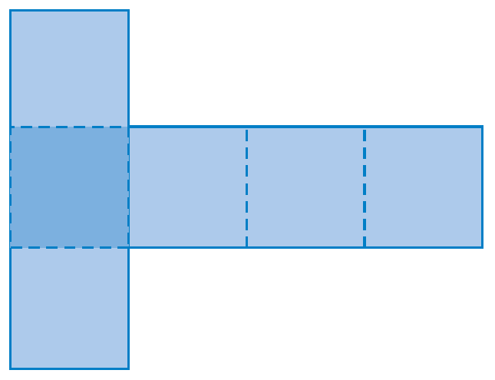
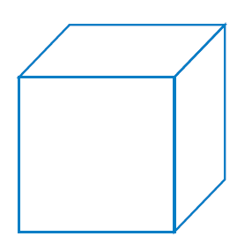
Topic: Measurement
EQ: How do we work out the surface area of cylindrical prisms?
What is Surface Area?
Recap from Last Lesson
Surface area of a prism is the sum of the areas of all its faces.
A two-dimensional representation of a solid is called a net

Slide 3
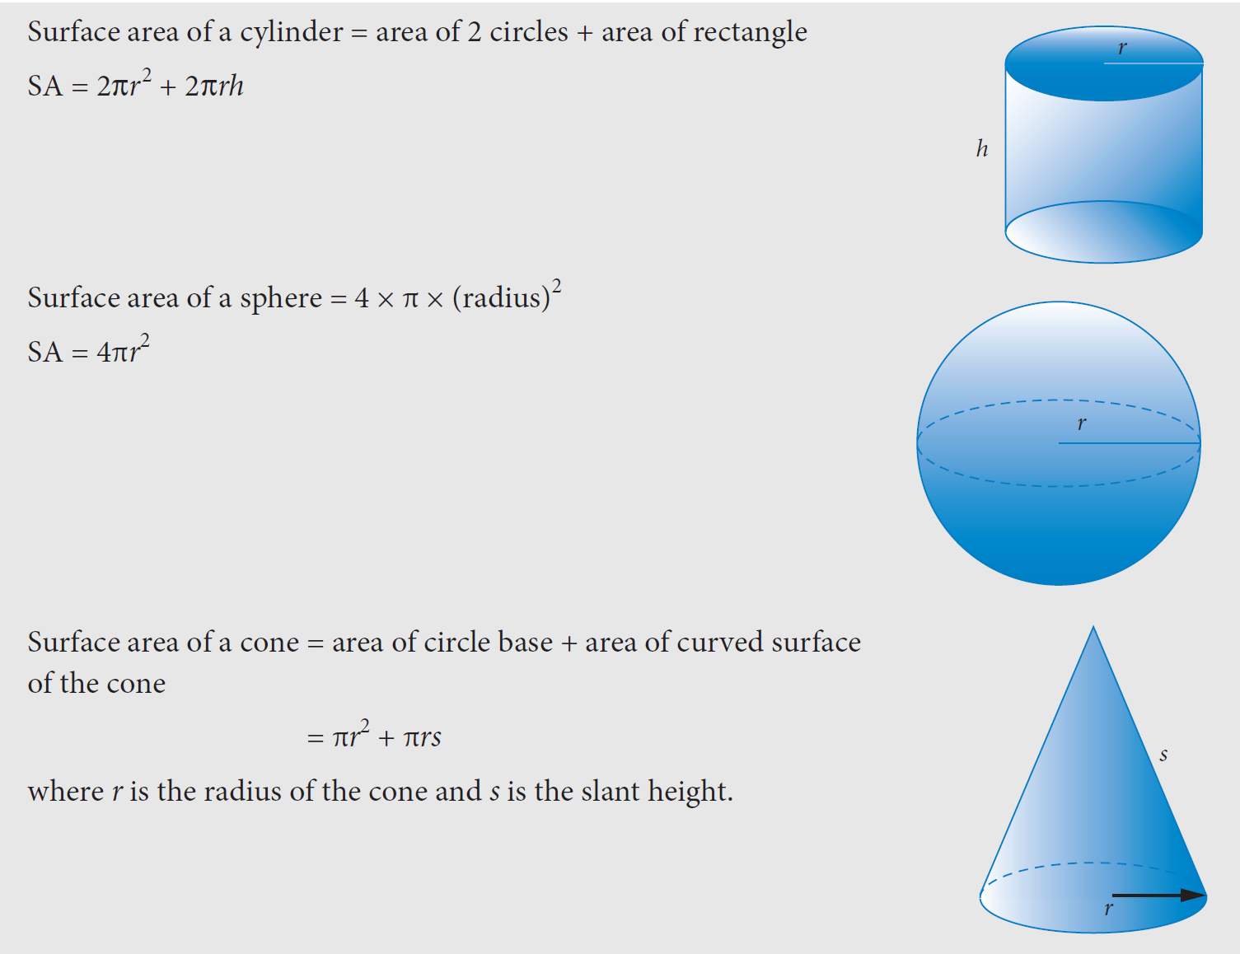

Slide 6
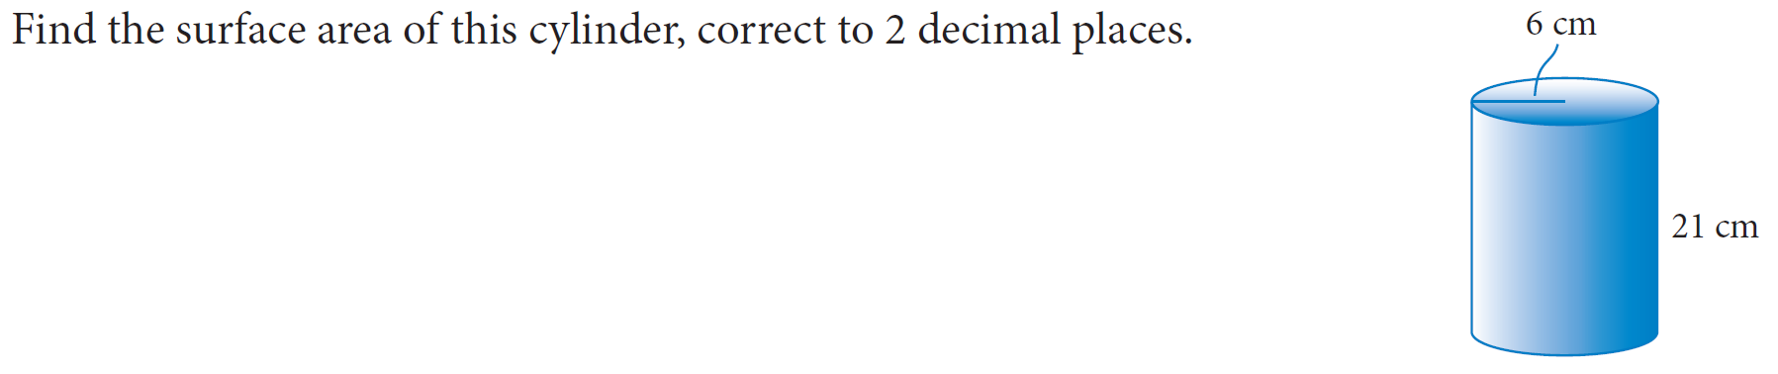

Slide 7
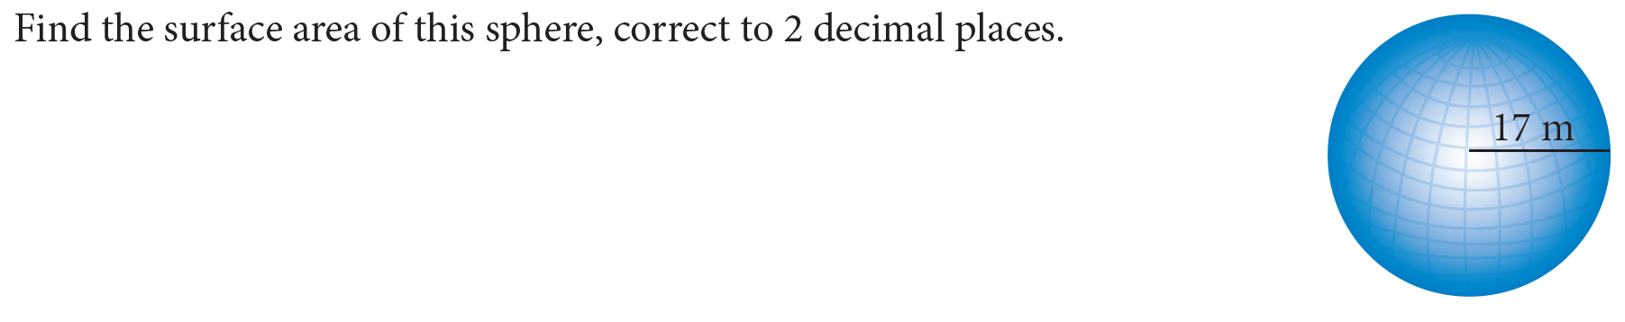

Slide 8
